Slide 1
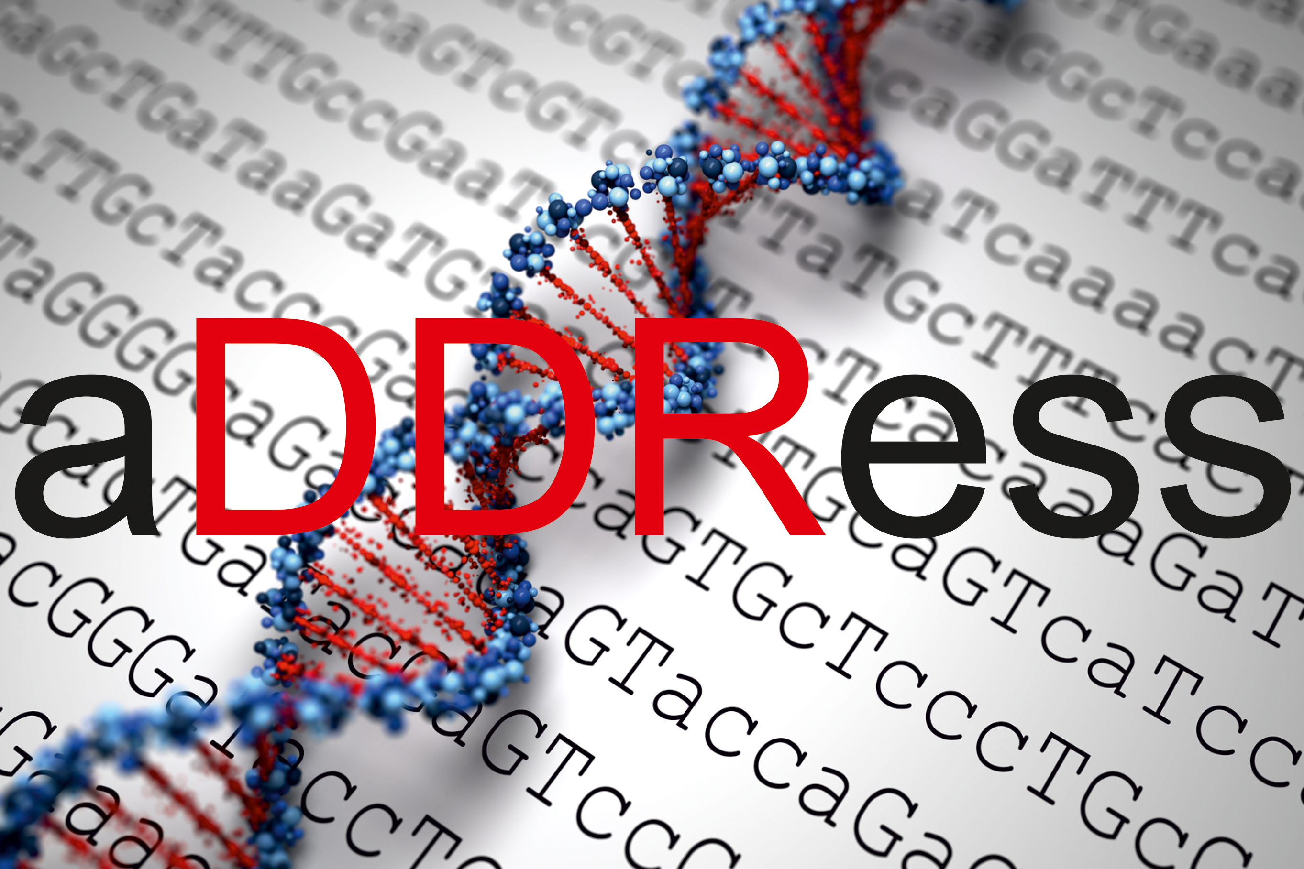
Joint Training and Research Programme
on
Chromatin Dynamics &
the DNA Damage Response
Welcome!

Slide 2
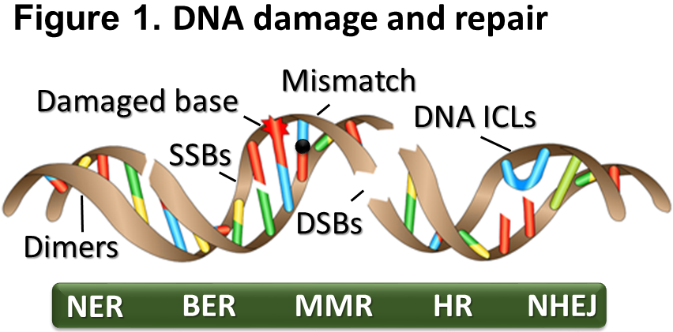
aDDRess focus

Slide 3
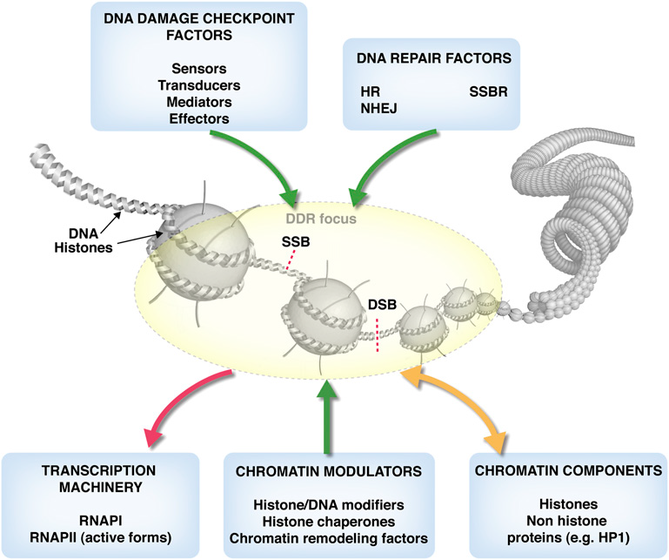
aDDRess scientific focus
NER

Slide 4
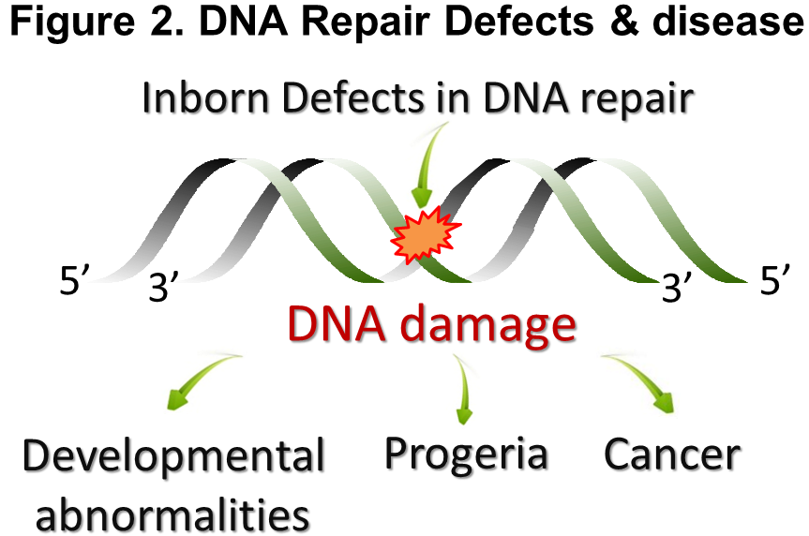
aDDRess scientific focus

Slide 5
aDDRess Objectives
-To establish a European research platform of excellence in the field of Chromatin dynamics and the DNA damage Response by integrating research from basic mechanisms to translational research applications.
-To create a Network dedicated to the high-quality training of ESRs promoting their independent careers, their own scientific goals and future employment prospects.
-To transform our long-term collaborations into a high-impact, intellectual network and build durable links between the participating labs and the industry (SMEs).

Slide 6
aDDRess Objectives in WPs
Table 1.1 | Work Package (WP) List
WP No. (section) | WP Title | Lead Beneficiary | Start Month | End month | Type of Activity | ESRs Involvement
WP1 (B.3.2) | Recruitment | FORTH | 1 | 6 | Management | No
WP2 (B.3.2) | Management & Evaluation | FORTH | 1 | 48 | Management | Yes
WP3 (B.1.2) | Training | LMU | 6 | 48 | Training | Yes
WP4 (B.1.1) | DNA repair mechanisms & Chromatin architecture | UCPH | 6 | 48 | Research | Yes
WP5 (B.1.1) | Genome maintenance in development & disease | EPFL | 6 | 48 | Research | Yes
WP6 (B.1.1) | Novel approaches for the study of DNA repair-deficient disorders | LXRepair | 6 | 40 | Research | Yes
WP7 (B.2.3.2) | Dissemination activities | CNRS | 6 | 48 | Dissemination | Yes
WP8 (B.2.3.1) | Public engagement | IFOM | 12 | 48 | Outreach | Yes

Slide 7
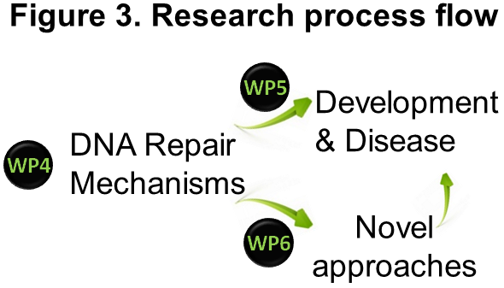
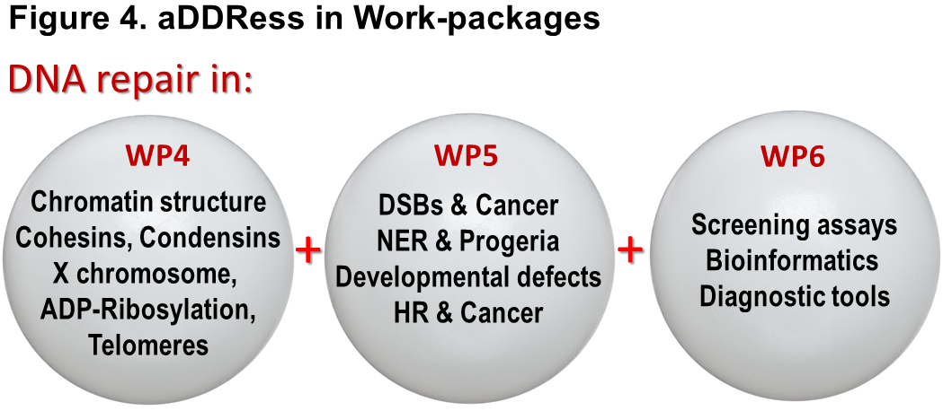
aDDRess Objectives in WPs
i. DNA Repair mechanisms & chromatin architecture (WP4).
ii. Genome maintenance in development and disease (WP5).
iii. Novel approaches to study DNA repair-deficient disorders (WP6)

Slide 8
aDDRess Participants
Consortium Member | Legal Entity short Name |  | Academic | Non-Academic | Awards Doctoral Degrees | Country | Dept./Division/Laboratory |  | Scientist-in-Charge | Role of Partner Organisation
Beneficiaries
1. IFOM Fondazione Instituto di Oncologia Moleculare |  | IFOM | ✓ |  | ✓ | Italy |  | DNA repair laboratory | Dana Branzei
2. Ludwig-Maximilians-Universitaet Muenchen |  | LMU | ✓ |  | ✓ | Germany |  | Department of Physiological Chemistry | Andreas Ladurner
3. Foundation for Research and Technology – Hellas |  | FORTH | ✓ |  | ✓ | Greece |  | Institute of Molecular Biology and Biotechnology | George Garinis Babis Spilianakis
4. Karolinska Institutet |  | KI | ✓ |  | ✓ | Sweden |  | Department of Medical Biochemistry and Biophysics | Nicola Crosetto
5. Stichting Het Nederlands Kanker Instituut-Antoni van Leeuwenhoek Ziekenhuis. |  | NKI | ✓ |  | ✓ | Netherlands |  | Division of Oncogenomics | Jacqueline Jacobs
6. Klinikum der Universitaet zu Köln |  | UKK | ✓ |  | ✓ | Germany |  | Institute for Genome Stability in Ageing and Disease | Björn Schumacher
7. Ecole Polytechnique Federale de Lausanne |  | EPFL | ✓ |  | ✓ | Switzerland |  | Swiss Institute for Experimental Cancer Research | Joachim Lingner
8. Université Paris Diderot-Paris 7 |  | Paris7 | ✓ |  | ✓ | France |  | Epigenetics and Cell Fate Center | Sophie Polo
9. Centre Nationale de la Recherche Scientifique |  | CNRS | ✓ |  | ✓ | France |  | Center de Biologie Intégrative | Gaëlle Legube
10. University of Copenhagen |  | UCPH | ✓ |  | ✓ | Denmark |  | The Novo Nordisk Foundation Center for Protein Research | Niels Mailand
11. Facultni Nemocnice U SV. Anny V BRNE |  | ICRC | ✓ |  | ✓ | Czech |  | Center of Biomolecular and Cellular Engineering | Lumir Krejčí
12. LXRepair SAS |  | LXRepair |  | ✓ | ✓ | France |  | R&D | Sylvie Sauvaigo
13. NorGenoTech AS |  | Norgenotech |  | ✓ | ✓ | Norway |  | R&D | Andrew Collins
14. Genevia Technologies Oy |  | Genevia |  | ✓ | ✓ | Finland |  | R&D | Matti Nykter

Slide 9
aDDRess Partners
Partner Organisations
1. Science and Technology Park of Crete | STEP-C |  | ✓ |  | Greece | R&D | Artemis Saitakis | Specialized courses
2. University of Geneva Medical School | UNIGE | ✓ |  |  | Switzerland | Department of Genetic Medicine and Development | Manolis Dermitzakis | Specialized courses
3. Computational Genomics group, University of Crete | CG² | ✓ |  |  | Greece | Department of Biology | Christoforos Nikolaou | Summer School
4. Clinical Trials Center of the University of Cologne | CTCC | ✓ |  |  | Germany | Department of Medical Writing & International Scientific Relations | Pauline Schumacher | Specialized courses
5. Institute of Electronic Structure and Laser | IESL | ✓ |  |  | Greece | In-vivo Imaging laboratory | Ioannis Zacharakis | Summer School
6. The International School for Advanced Studies | SISSA | ✓ |  |  | Italy | Science Communication | Anna Menini | Specialized courses

Slide 10
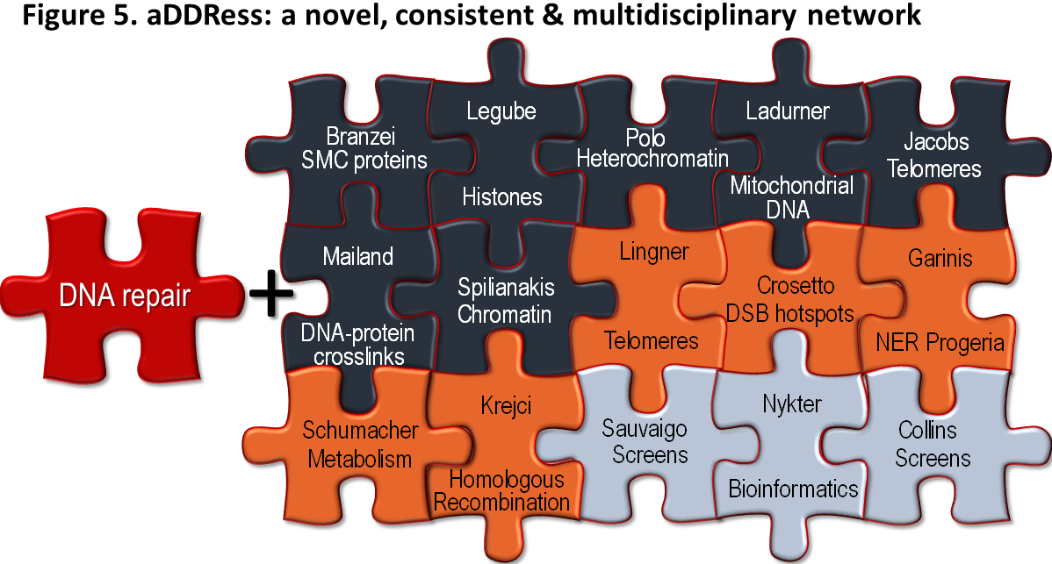
Participants:
a. coloured with respect to WP
b. arranged according to scientific relevance

Slide 11
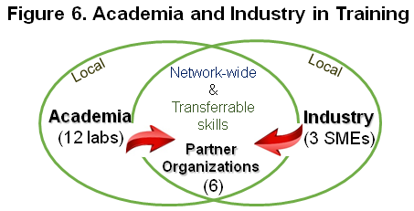
aDDRess Training

Slide 12
aDDRess Training
Local:
-Individual research-driven training
-Training in local group meetings and journal clubs
-Joint group meetings
-Training in Local Departmental Meetings, Seminar Series
-Local PhD training programmes
Network-wide:
i. Training workshops organized by the Network:
Workshop 1: “DNA repair mechanisms & Chromatin remodelling” (Cologne, Schumacher)
Workshop 2: “DNA repair and DDR: cellular metabolism & diseases” (Milano, Branzei)
Workshop 3: “DNA Replication and Transcription upon DNA damage” (Ladurner, Munich)
Workshop 4: “Biomarker discovery in DNA repair-associated pathologies” (Norgenotech, Oslo)
ii. Organisation of aDDRess Summer Schools:
-The Bioinformatics Summer School (FORTH)
-The Bioimaging Summer School (CNRS-Paris7)
iii. Organisation of Annual Network Meetings
iv. Organisation of a final Network Conference (Heraklion, Garinis)
vi. Attendance at international conferences and symposia
vii. Specialized, task-centred learning during secondments

Slide 13
Network-wide training events
Table 1.2 b Main Network-Wide Training Events, Conferences and Contribution of Beneficiaries
 | Main Training Events & Conferences | ECTS | Lead Institution | Project Month
1 | Initial Network Meeting |  | FORTH | 1
2 | 1st Annual Meeting | 1 | UKK | 8
3 | Workshop 1: “DNA repair mechanisms and Chromatin remodelling” | 5 | UKK, Norgenotech, UCPH | 8
4 | 2nd Annual Meeting | 1 | IFOM, ICRC | 18
5 | Workshop 2: “DNA repair and DDR: from molecular mechanisms to disease” | 5 | IFOM, Genevia, | 18
6 | 1st aDDRess Summer School | 3 | FORTH, UKK, CG² | 22
7 | 3rd Annual Meeting |  | LMU | 30
8 | Workshop 3: “DNA Replication and Transcription upon DNA damage” | 5 | LMU, LXRepair | 30
9 | 2nd aDDRess Summer School | 3 | IGBMC, GURDON, IESL | 38
10 | 4th Annual Meeting | 1 | KI, Genevia | 42
11 | Workshop 4: “Biomarker discovery in DNA repair-associated pathologies” | 5 | Norgenotech, LXRepair, Genevia | 42
12 | Final Network Conference | 4 | FORTH | 46
 | Main Transferrable skills courses | ECTS | Lead Institution | Project Month
13 | Course 1: Project Management | 3 | NKI, STEP-C, LXRepair | 8
14 | Course 2: Laboratory Animal Science | 6 | FORTH, IFOM | 18
15 | Course 3: Communication, Scientific Writing & Presentation | 3 | NKI, CTCC, SISSA, UNIGE | 24
16 | Course 4: Bioethics | 3 | UKK, FORTH, KI | 30
17 | Course 5: Business & Entrepreneurship | 2 | Norgenotech, STEP-C | 42

Slide 14
Network-wide training events: how it works!
An example:
Day 1:
-Management meeting (1-2 hours)
-Annual meeting (ESRs present their progress on the project for 15 min + 5 min questions)
Day 2:
Workshop 1 (5-8 local and aDDRess speakers)
Day 3 (only for ESRs):
-a 2-3 hours course or a summer school (2-3 speakers on the topic for 2-3 hours)
Expenses:
-PIs cover their accommodation/travelling expenses from management & indirect costs
-Coffee breaks, lunches and dinners: the organizer issues an invoice to all beneficiaries
(50-200 euros)
-ESRs cover their accommodation/travelling expenses from research costs

Slide 15
PERSONAL CAREER DEVELOPMENT PLAN
The Personal Career Development Plan (PCDP) will be an organizational scheme ensuring that all types of training activities (Local and Network-wide) and the scientific resources of the consortium will be exploited in an optimal way tailored to the individual ESR.
The researcher and personal supervisor will establish an initial PCDP within the first month of the commencement of training.

Slide 16
Size, Structure & balance of the training program
Table 1.2 a | Recruitment Deliverables
Researcher | Recruiting Participant | Start Month | Duration (months)
ESR1 | IFOM | 6 | 36
ESR2 | CNRS | 6 | 36
ESR3 | Paris7 | 6 | 36
ESR4 | LMU | 6 | 36
ESR5 | NKI | 6 | 36
ESR6 | UCPH | 6 | 36
ESR7 | FORTH | 6 | 36
ESR8 | EPFL | 6 | 36
ESR9 | KI | 6 | 36
ESR10 | FORTH | 6 | 36
ESR11 | UKK | 6 | 36
ESR12 | ICRC | 6 | 36
ESR13 | LXRepair | 6 | 36
ESR14 | Genevia | 6 | 36
ESR15 | Norgenotech | 6 | 36
Total | 15 ESRs |  | 540

Slide 17
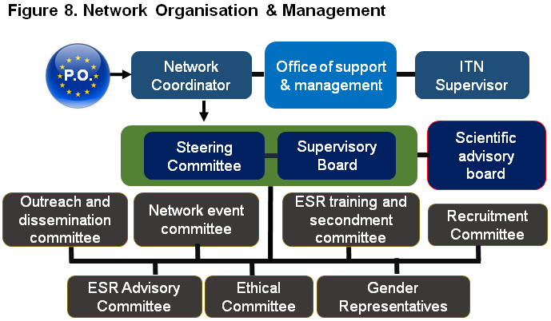
Network Organisation and Management Structure

Slide 18
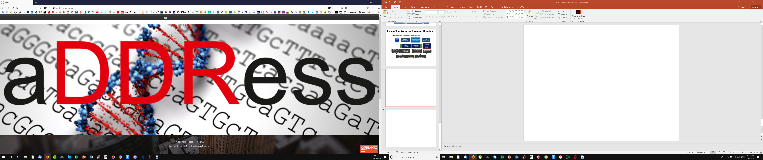
Our website: www.itn-address.gr

Slide 19
aDDRess Management

Slide 20
aDDRess Management
1. aDDRess is an ETN: European Training Network
ETN: provides post-graduate training in specific and inter-disciplinary scientific fields.
2. ESRs should be registered for a PhD but the PhD itself is not a deliverable
3. Coordinator's obligations
-Monitor that the action is implemented properly
-Act as intermediary for all communication between consortium and the REA
-Request and review any document or information required by the REA
(completeness, correctness and quality)
-Submit the deliverables and reports to the REA
-Ensure that all payments to other beneficiaries are made without unjustified delay
-Inform the REA of the amounts paid to each beneficiary
The Coordinator cannot delegate these tasks to any other beneficiary
or subcontract them to a third party.
For all other duties, the Coordinator will recruit a Program manager

Slide 21
aDDRess Management
4. Role of the Beneficiaries
-Article 41.2a of the GA
-Keep the Beneficiary Register up to date
-Inform the Coordinator of events likely to affect/delay the implementation of the project
-Submit to the coordinator in good time:
•Individual financial statements
•Data needed to draw up the technical reports
•Ethics committee notifications/authorizations for activities raising ethics issues
•Any other document required by the REA
-Beneficiaries are jointly liable for the technical implementation of the action.
-Beneficiaries have individual responsibility for their own financial statement.

Slide 22
aDDRess Management
5. Consortium Agreement (CA)
Internal arrangement between the beneficiaries.
Essential for the smooth implementation of the project
Covers:
1)the internal organization of the consortium
2)management of access to the electronic exchange system
3)distribution of EU funding
4)additional rules on rights and obligations related to background and results
5)Settlement of internal disputes
6)liability and confidentiality arrangements between the beneficiaries
The CA must not contain any provision contrary to the Agreement.
The CA should be submitted as deliverable at the beginning of the project.
The version signed by all beneficiaries should be uploaded in the Continuous Reporting

Slide 23
aDDRess Recruitment
Eligibility:
Nationality: any
2. Mobility rule: The researcher must not have resided or carried out his/her main activity
(work, studies, etc.) in the country of his/her host organization for >12months
in the 3 years immediately prior to his/her recruitment.
Note: Short stays, such as holidays, are not taken into account.
3. Stage rule: ESR shall at the date of recruitment by the host organization, be in
the first 4 years (full-time equivalent research experience) of their research careers
and have not been awarded a doctoral degree in any discipline.
4. Duration of recruitment: min 3 months to max 36 months
Note: The participant is strongly encouraged to find additional funding from other sources in
order to fund the 4th year of doctoral studies.

Slide 24
aDDRess Recruitment
Recruitment process:
-Advertise and publish vacancies internationally
•Beneficiaries must publish vacancies as widely as possible,
•Obligatory publication in the EURAXESS Jobs Portal
-Follow an open, transparent, impartial, equitable and merit-based recruitment
procedure
-Ensure that no conflict of interest exists in or arises from the recruitment
(family, economic interest, emotional life, …)
-The consortium should agree on drafting and advertising the vacancies.
-Use a common recruitment platform for receiving applications.
Once you have hired the ESR:
-Ensure that a personal career development plan is established and is agreed upon
and signed by the Supervisor and the researcher. Regular updates needed!
-Ensure that the researcher works on an individual research project
-Secondments: up to 30% of the recruitment period. Short stays don’t count.
-Non-compliance may lead to a reduction of the Grant

Slide 25
aDDRess Recruitment
Recruitment process:
Once you have hired the ESR:
-Ensure that a personal career development plan is established and is agreed upon
and signed by the Supervisor and the researcher. Regular updates needed!
-Ensure that the researcher works on an individual research project
-Secondments: up to 30% of the recruitment period. Short stays don’t count.
-Each beneficiary must submit a 'researcher declaration' within 20 days after the recruitment of
The ESR (Art. 19.1 of the GA).
-Non-compliance may lead to a reduction of the Grant

Slide 26
aDDRess Recruitment
Don'ts!
-The Researcher is recruited by one beneficiary but in reality is hosted at another
institution. (Must be physically hosted at the premises of the recruiting beneficiary).
-Recruited researchers seconded to organizations outside the consortium.
-The researcher recruited to work in the project is in reality a "normal "employee at the
university/company that works on non-project-related tasks.
-Recruited fellows must work full-time on the project.
-Direct recruitment of fellows without fair and transparent recruitment process
-Playing with the recruitment date for the eligibility of the researcher.
-The host has no real premises

Slide 27
aDDRess Reporting
Progress report (12 months + 60 days)
Periodic technical report (24months + 60 days)
Periodic technical report (48 months + 60 days)
Final report (48 months + 60 days)
Continuous reporting
-publishable summary,
-deliverables,
-milestones,
-critical risks,
-publications,
-patents,
-gender
-researcher declarations

Slide 28
Joint Training and Research Programme
on
Chromatin Dynamics &
the DNA Damage Response

